Slide 1
The Impact of Artificial Intelligence on Employment
A History, Culture & Civilization Project...

Slide 2
TABLE OF CONTENTS
Introduction
Results
Contrasting Perspectives
Genesys opinion survey
Survey of Corporate Management and Economic Policy (RIETI)
Study done by Georgios Petropoulos with the assistance of Nicolas Moës
Optimist’s perspective
Doomsayer’s perspective
Unifying perspectives
Method of Analysis
Word Cloud
Genesys opinion survey
Survey of Corporate Management and Economic Policy (RIETI)
Study done by Georgios Petropoulos with the assistance of Nicolas Moës
Conclusion
References

Slide 3
INTRODUCTION
AI and related technologies are being heralded as “the next big thing”, one that promises to revolutionize many areas of economic activity and thus to have a profound impact on economic growth. While technology generally increases productivity, AI may diminish some of today’s valuable employment opportunities.
The substitution of human labour by Artificial Intelligence and robots is a keenly debated topic. Some claim that a substantial share of jobs is at risk, while others argue that computers and robots will lead to product innovations and hence to unimaginable new occupations.
Technological innovations can affect employment in two main ways:
Displacement effect: by directly displacing workers from tasks they were previously performing .
Productivity effect: by increasing the demand for labour in industries or jobs that arise or develop due to technological progress .

Slide 4
CONTRASTING PERSPECTIVES
Rapid technological progress and innovation can threaten employment. Such a concern is not new but dates back at least to the 1930s, when John Maynard Keynes postulated his “Technological Unemployment Theory” – technological change causes loss of jobs (Keynes 1937). But some other researchers argue that AI may create new employment opportunities that are currently unimaginable, and technology-intensive emerging firms may create many new occupations, thus making its way for contrasting perspectives:
Optimist’s Perspective: Optimists suggest that technology may substitute for some types of labor but that efficiency gains from technological augmentation outweigh transition costs and, in many cases, technology increases employment for workers who are not in direct competition with it (although recent follow-up work suggests these are temporary gains).
For example, workers may require more social skills because those skills remain difficult to automate. Even if technology depresses employment for some types of labor, it can create new needs and new opportunities through “creative destruction”.

Slide 5
Doomsayer’s Perspective: Technology improves to make human labor more efficient, but large improvements may yield deleterious effects for employment. This obsoletion through labor substitution leads many to worry about “technological unemployment” and motivates efforts to forecast AI’s impact on jobs.
One study assessed recent developments in AI to conclude that 47% of current US employment is at high risk of computerization, while a contrasting study, using a different methodology, concluded that a less alarming 9% of employment is at risk.
Unifying Perspectives: On one hand, multiple dynamics accompany technological change and create uncertainty about the future of work. On the other hand, experts agree that occupations are best understood as abstract bundles of skills and that technology directly impacts demand for specific skills instead of acting on whole occupations all at once.
Existing studies have argued theoretically that different skill types underpin aggregate labor trends, such as “job polarization” and “urban migration”, but robust empirical validation is made difficult by the specificity of modern skills data and their temporal sparsity.

Slide 6
METHOD OF ANALYSIS
The data used in this paper originate from three studies which are :
Genesys opinion survey: A nationwide online - survey was conducted by Genesys in April 2019 which included 1,001 currently employed U.S adults over the age of 18. They were asked about the current and future effects of AI in the workplace. Participants across industries were asked to select the three jobs most likely to be replaced by AI from among the following options:
Accountant/Tax Preparer
Data Entry
Food Service
Insurance Underwriters
Manufacturing
Paralegal
Pharmacist
Retail/Checkout Clerk
Telemarketer
Transportation/Driver
Others

Slide 7
Survey of Corporate Management and Economic Policy (RIETI): This survey was conducted from October to December 2015 to a variety of public and private Japanese firms operating in both manufacturing and service industries. A total of 3,438 firms responded to the survey (response rate was 22.9%).
The breakdown of firms by industry are as follows:
Manufacturing 1,647 (48.1%)
ICT 199 (5.8%)
Wholesale 639 (18.6%)
Retail 403 (11.8%)
Services 395 (11.5%)
Other industries 144 (4.2%)
The survey inquiry was wide-ranging, but in this project, we have focused on basic firm characteristics available from the survey, such as industry, firm size (total number of employees), and employee composition.

Slide 8
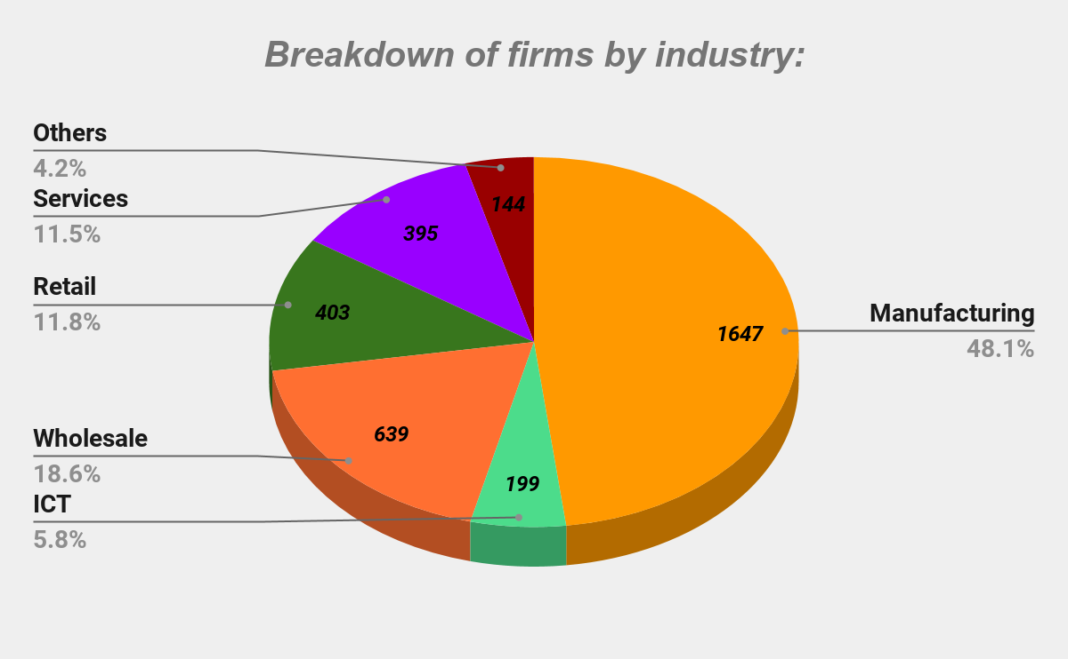
Fig. 1: Pie chart showing breakdown of firms by industry

Slide 9
Study done by Georgios Petropoulos with the assistance of Nicolas Moës: A new wave of automation and advanced machine-learning techniques is on its way, in which intelligent machines will be increasingly capable of carrying out high-skill and possibly non-routine tasks. Moving from the efficiency gains in online trading to the extensive use of artificial intelligent systems in the industrial production, concerns about the potential displacement of labour emerge.
This study examines the most important question: Which of the two labour market effects - displacement or productivity – will dominate in the artificial intelligence (AI) era?
Three approaches has been used to answer this question :
Examine the impact of technological breakthroughs on labour markets in previous industrial revolutions.
Assess the risk of occupations and tasks to be automated in the next decades because of AI systems.
Assessing the impact of AI on employment:

Slide 10
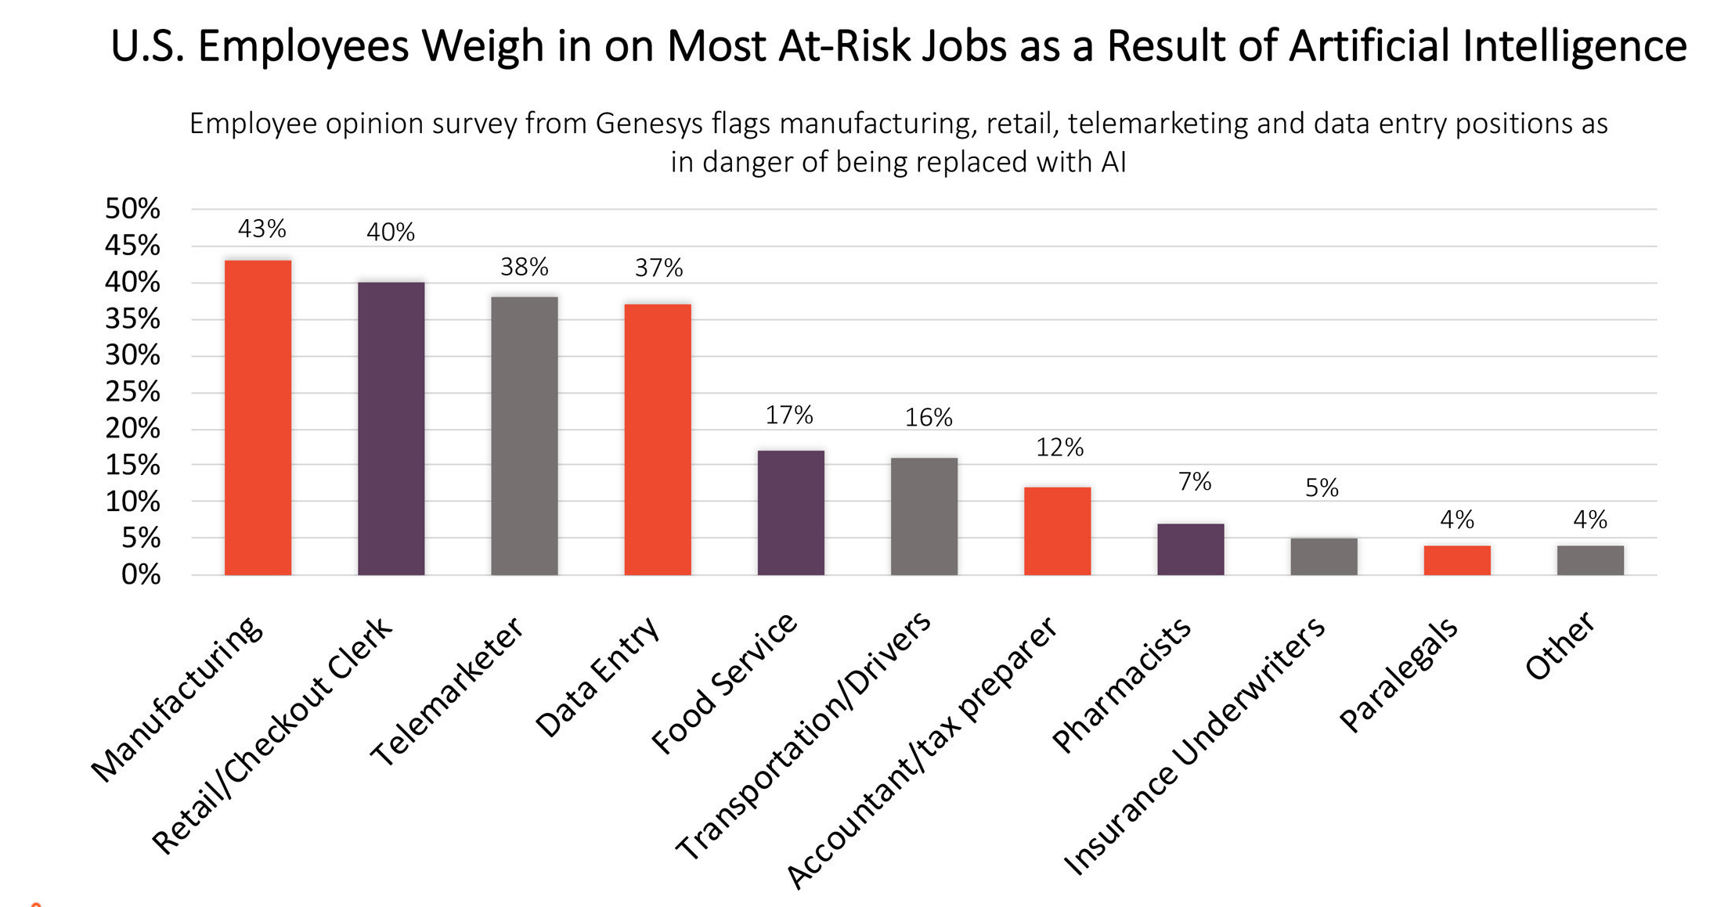
RESULTS
Genesys opinion survey: The results from Genesys opinion survey showed that U.S. employees working in education/training and doctor/nurse/caregivers were the least afraid that AI/bots would take their jobs within the next 10 years.
Fig. 2: Responses from 1001 currently employed US adults (April 2019)
Source: Genesys (https://www.genesys.com/)

Slide 11
Survey of Corporate Management and Economic Policy (RIETI): The perception of the impact of AI on employment is generally negative: 21.8% of firms responded that the development and diffusion of new technologies will decrease the number of their employees, and the share of firms expecting positive effects on their employment is notably small (3.7%). However, 28.6% of firms expect no impact of AI on their employment and 45.8% of firms responded as “don’t have any idea.”
Industry | (1) Increase | (2) No impact | (3) Decrease | (4) Don't have any idea
Manufacturing | 3.0% | 21.8% | 29.3% | 45.9%
ICT | 15.9% | 30.7% | 13.8% | 39.7%
Wholesale | 2.0% | 30.7% | 13.9% | 53.4%
Retail | 1.9% | 37.8% | 16.8% | 43.6%
Services | 6.7% | 42.3% | 14.2% | 36.8%
Other | 0.7% | 33.3% | 15.6% | 50.4%
Total | 3.7% | 28.6% | 21.8% | 45.8%

Slide 12
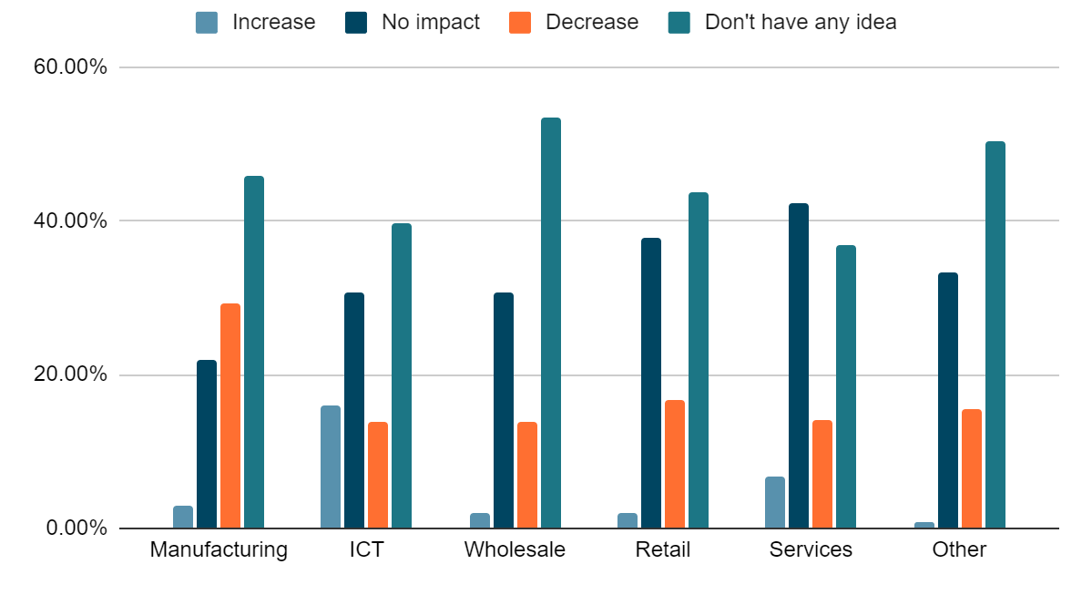
Fig. 3: Impact of AI on employment

Slide 13
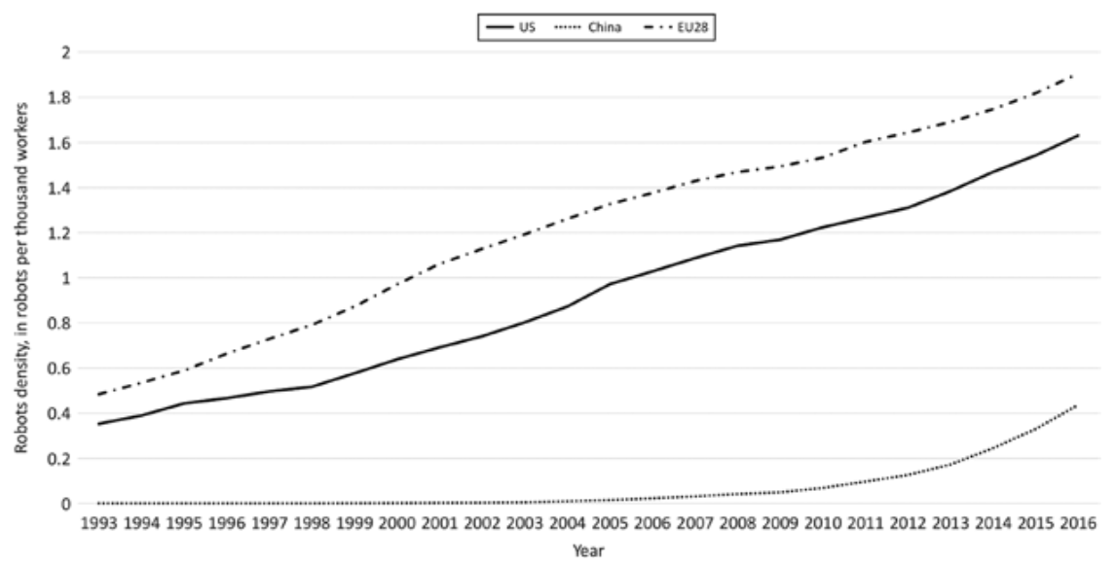
Study done by Georgios Petropoulos with the assistance of Nicolas Moës: This study concludes the following results regarding the impact of AI on employment:
The EU so far has been the region with the most robots in operation, followed by the US while China is behind.
Fig. 4: No. of operational industrial robots per thousands of workers in China, EU and US.

Slide 14
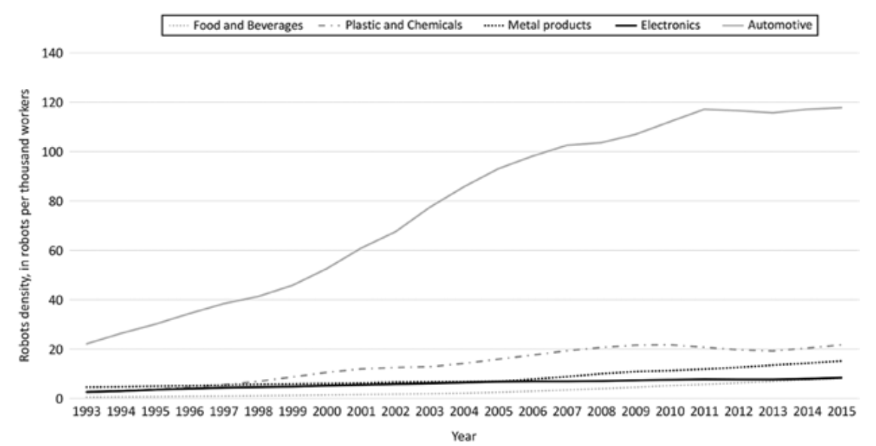
The EU automotive industry has introduced by far the most industrial robots in its production process, followed by the plastic and chemicals sector.
Fig. 5: Operational industrial robots density in different sectors in EU countries.

Slide 15
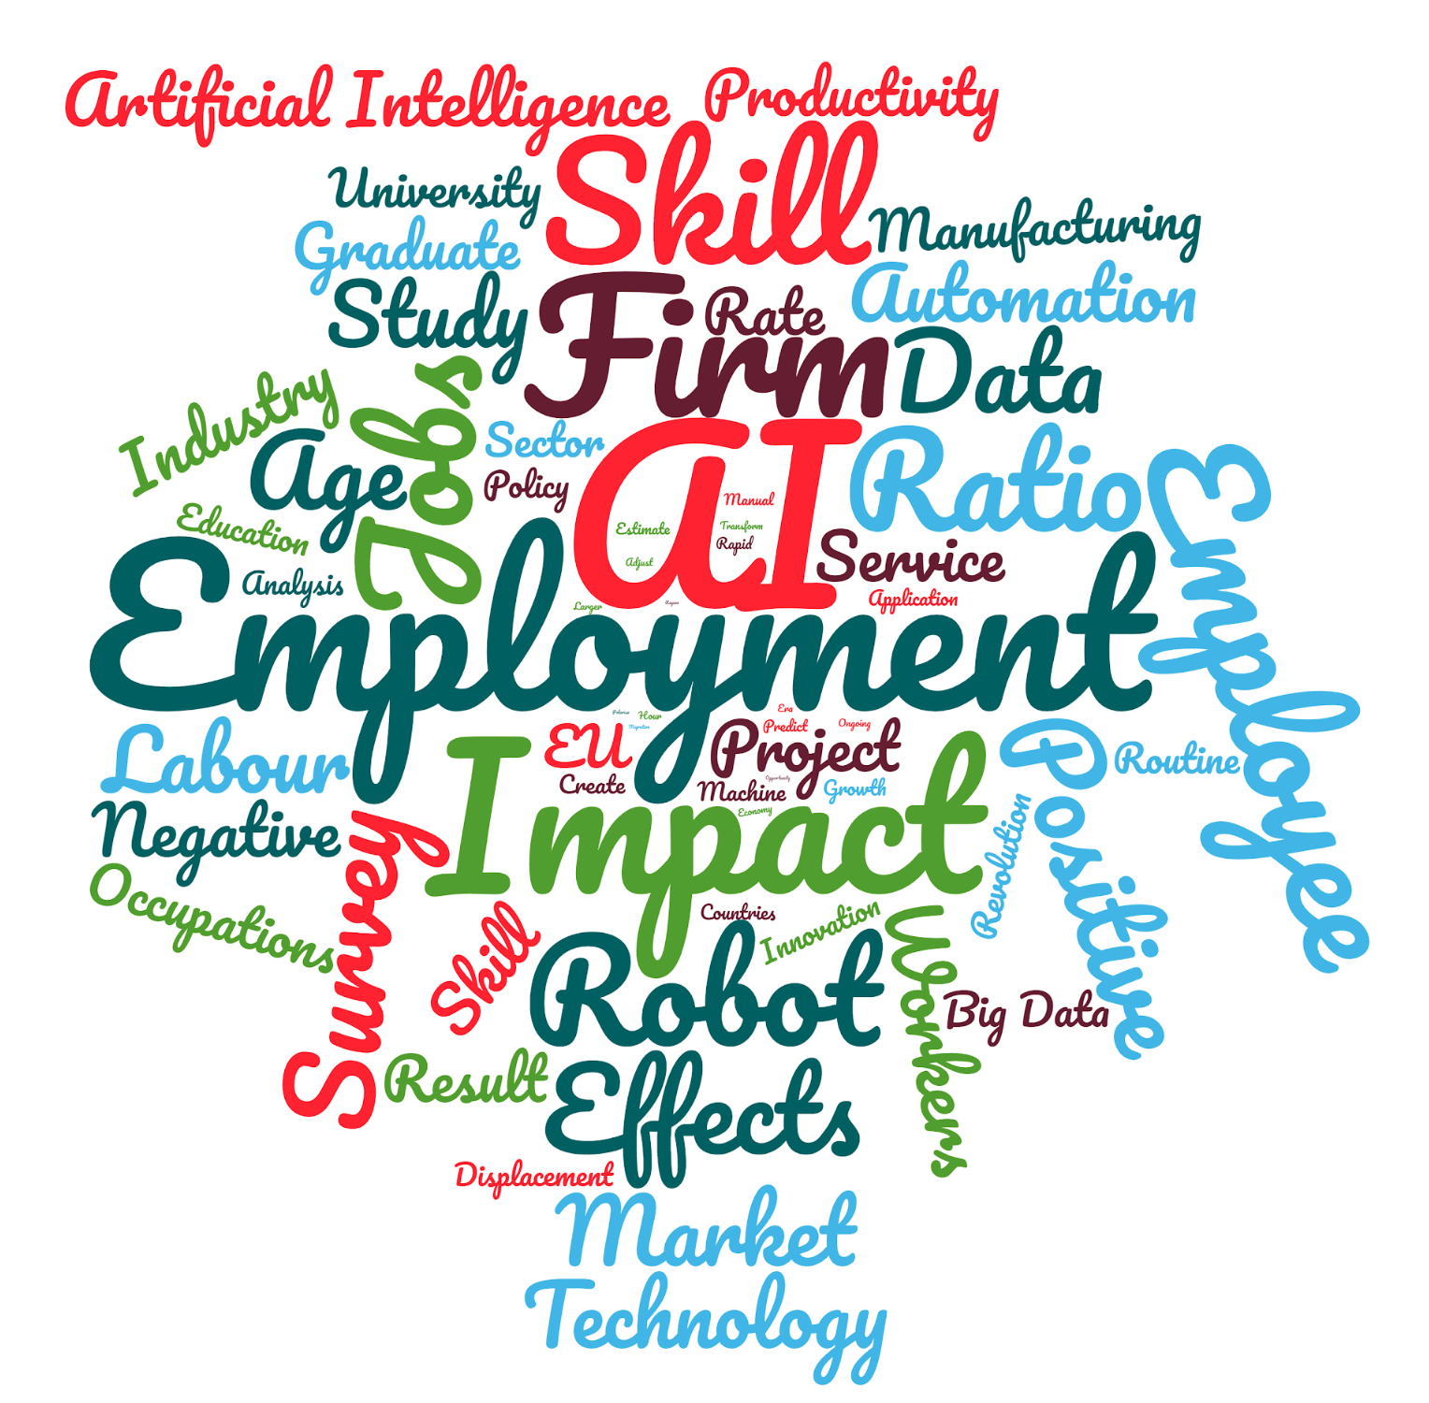
WORD CLOUD
Fig. 6: Word cloud showing visual representation of text data used on this project, typically used to depict keyword metadata (tags) or to visualize free form text.

Slide 16
CONCLUSION
This project analyzes the attitude of firms toward Artificial Intelligence (AI) as well as their views regarding the impacts of these new technologies on future business and employment prospects.
Although this study is limited to simple calculations from cross-sectional survey data and the information regarding the AI-related technologies includes subjective assessments, it presents novel findings regarding this topic. The results of this study indicate the following:
Firms operating in the service sector generally have a positive attitude toward the use of Artificial Intelligence. This finding suggests that we should pay attention to “AI-using industries” including a large number of service industries, similar to the experience from the “IT revolution”. Because improving productivity performance of the service sector is imperative to enhance the potential growth rate of advanced economies, diffusion and application of AI-related technologies in the service sector are highly expected.

Slide 17
AI and the skill level of the firm's’ employees are complementary. In particular, we should pay attention to the strong complementarity found at the relatively higher end of the skill distribution. This finding suggests that in order to accelerate the development and diffusion of AI-related technologies and, at the same time, to maintain employment opportunities, it is necessary to upgrade human capital, such as increasing the number of employees with postgraduate education.
Firms operating in global markets reported a positive attitude toward the impact of AI-related technologies, indicating that globalization of economic activities, such as expanding Economic Partnership Agreements (EPAs), will facilitate the development and diffusion of AI-related innovations, and active investment in utilizing these new technologies will promote further globalization of economic activities.

Slide 18
REFERENCES
Artificial Intelligence
From: https://plato.stanford.edu/entries/artificial-intelligence/
https://www.investopedia.com/terms/a/artificial-intelligence-ai.asp
http://sitn.hms.harvard.edu/flash/2017/history-artificial-intelligence/
Fernald, J.G. (2015), “Productivity and Potential Output before, during, and after the Great Recession,” in NBER Macroeconomics Annual 2014, edited by J.A. Parker, and M. Woodford. Chicago: University of Chicago Press, 1–51.
Frey, C.B., and M.A. Osborne (2013), “The Future of Employment: How Susceptible Are Jobs to Computerisation?” mimeograph, Oxford Martin School.
Morikawa, M. (2016), “The Effects of AI and Robotics on Business and Employment: Evidence from a Survey on Japanese Firms,” RIETI Discussion Paper, 16-E-066.

Slide 19
Morikawa, M. (2015), “Postgraduate Education and Labor Market Outcomes: An Empirical Analysis Using Micro Data from Japan,” Industrial Relations 54, 499–520.
Toward understanding the impact of artificial intelligence on labor
From : https://www.pnas.org/content/116/14/6531
THE IMPACT OF ARTIFICIAL INTELLIGENCE ON EMPLOYMENT By Georgios Petropoulos
‘Do We Understand the Impact of Artificial Intelligence on Employment?’ published by Bruegel (Petropoulos 2017a). The superb research assistance by Nicolas Moës is gratefully acknowledged
The Economist (2016), ‘Automation and Anxiety’, The Economist, 25 June, From::http://www.economist.com/news/special-report/21700758-willsmarter-machines-cause-mass-unemployment-automation-and-anxiety
Goos, M. and A. Manning (2007), ‘Lousy and Lovely Jobs: the Rising Polarization of Work in Britain’, The Review of Economics and Statistics, 89(1): 118–33.

Slide 20
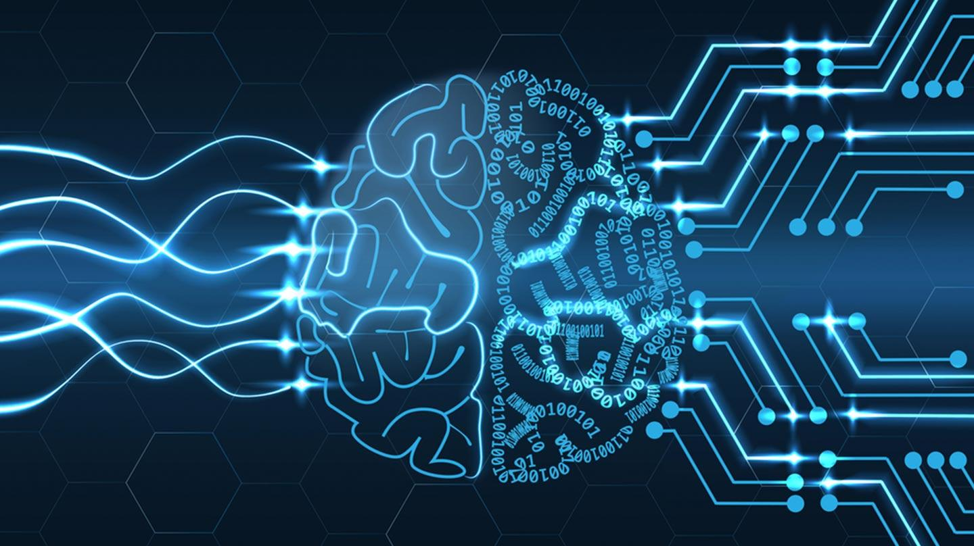

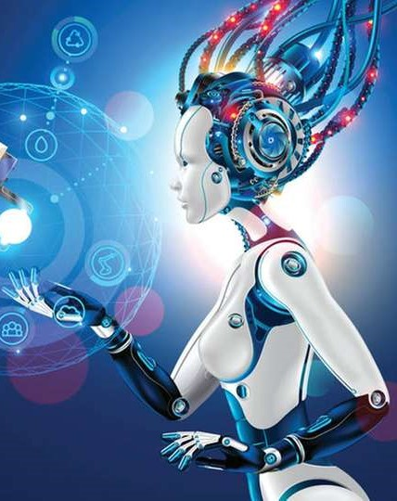
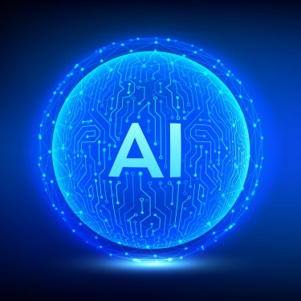
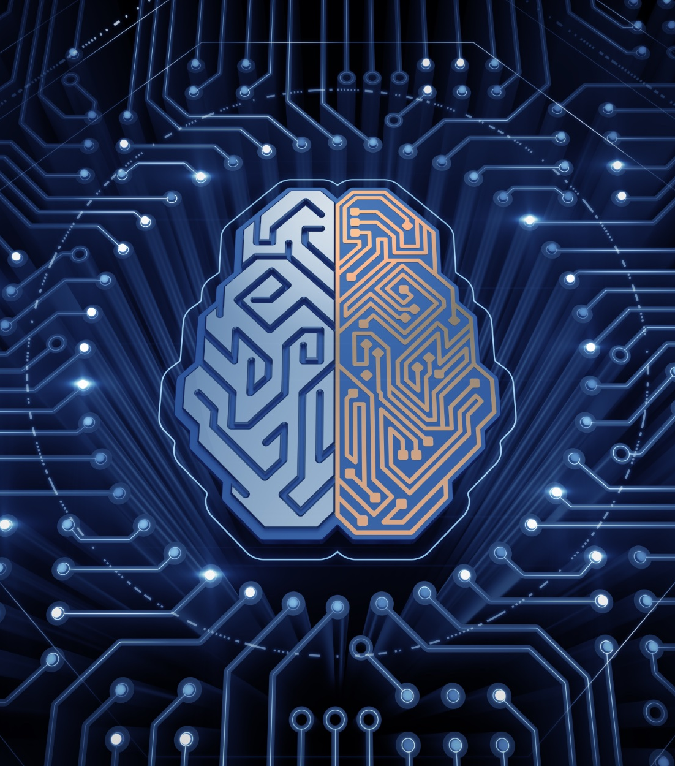
Thank you!
Presented By:
Amit Katyal (11807)
Ashutosh Jha (11811)
Tushar Sethi (11840)

